Slide 1
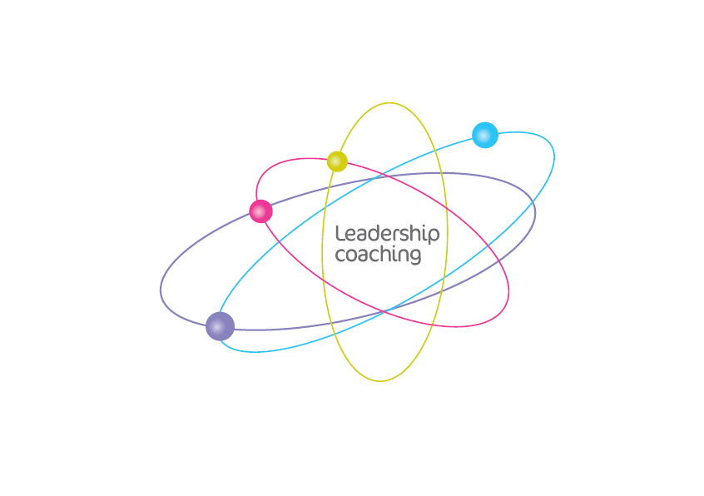
The Professional Leadership Coaching Model
©2009 The Forton Group Limited
Notes:
Welcome to the Forton Group – we specialize in leadership development – my name is Bob and I’m the CEO
Great leadership is known to be the most important factor in being a high performing organisation
Leadership coaching builds this.
What we also know is that great leaders lead in a coach-like way – and our model supports them to achieve this
Successful Executive and Leadership coaching is a specialist set of skills
This presentation takes you through the key elements of our leadership coaching model

Slide 2
The purpose of leadership coaching in organisations
Support
talented
people
Improve the
culture
More effective
communications
Develop
coach-like
leaders
Leadership Coaching & the ‘Coach-Approach’
Deliver
Transformation &
Change
Provide
skills
toolkit
Improves personal
Learning &
Innovation
Unlock
value
Notes:
Leadership coaching is a powerful tool that unlocks real change in organisations
Coaching leaders improves the culture and delivers in all these areas
It supports talented people within organisations to become more confident and more effective
Leaders who adopt a coach-approach have another style of leadership for their toolkit
This will truly engage people; conversation by conversation
It enables them to be more productive and effective
It frees up leaders to achieve more and focus on what’s really important

Slide 3
Our coaching definition
“Coaching is …
Supporting people to lead, succeed, & achieve
Without doing it for them,
Or telling them how to do it.”
Notes:
Organisations employ people for their abilities and their potential;
coaching supports people to unlock that potential and deliver on their abilities –
People learn by doing and improve by being stretched
And, if you tell someone what to do or how to do it, you create dependency

Slide 4
The ‘who’, the ‘what’ & the ‘how’
Who
What
How
“Leadership is more than a position: it’s who we are, what we achieve and how we do it.”
Notes:
Leadership isn’t just about the position in the hierarchy;
it’s about people taking responsibility and taking ownership for what needs to be done in the moment
It’s about who we are, what we achieve and how we do it.

Slide 5
The Forton Group leadership definition
“Leadership is about people being successful
and
enabling success in others.”
Notes:
Leadership coaching is about what the leader can achieve through harnessing the skills and motivation of the group
Great leaders ensure the success is shared

Slide 6
Notes:
So for us, leadership is about individual achievement, and it’s about the success of the team, the organisation and the society in which we operate.
21st century leadership is ‘influential’ – this is not a style, it’s a necessary way of being. We need to be in touch with, and influence, those around us – at whatever level in the hierarchy – inside and outside our organisation.
Leadership is a 360 degree experience; great leaders are personally successful and they enable success in others

Slide 7
The Forton Group coaching model
The Field
The Principles
The Steps
The Skills
Notes:
Leadership coaching conversations enable success – both for the leader and for the wider world on which they impact
The Professional Leadership Coaching Model ignites excellence in leadership, by looking for and expecting the best in people.
In the Forton Group Model, Leadership Coaching conversations have four inter-connected elements:
The Skills used by the Leadership Coach
The Steps taken through the conversation
The focus on The Field or what’s in the world of the Coaching Client
The Principles adopted by the Professional Leadership Coach

Slide 8
Element 1: the skills
Notes:
The four key skills of leadership coaching are:
Questioning
Listening
Reflecting
Supporting
There’s an inner loop here – with the majority of the Coach’s time focused on asking questions, listening to the answers and reflecting on what they’ve heard.

Slide 9
Element 2: the steps
Notes:
Leadership Coaching conversations start with Purpose – who the leader is being, what values they hold and what their leadership vision is.
2. The conversation then moves to current Reality – where the leader is now, what resources they have access to, what strengths they bring. Reality provides a focus for the next step: plan.
3. The next step in the conversation is to explore their Plan – how they are going to bridge the gap between current reality and vision, what options are available and how that links back to their core purpose. Planning provides options (and SMART thinking).
The emotional connection to the vision provides inspiration
The emotional connection to available resources provides motivation
Planning, to build on resources, and achieve the goals – provides the optimism
4. The person being coached then takes action, based on the plan, and fieldwork agreed with the Leadership coach. These include ‘challenges’ (delivering on the plan) ‘ponder questions’ (issues for the person being coached to consider) and impacts which they ‘just notice’ . Action provides experience.
5. The final step is the Review, when the person being coached comes back and reviews what happened, or didn’t happen, what they learned, what went well and what they might do differently in future. The Review step results in learning.
The coaching conversation isn’t a single, linear process – it can loop back at any step

Slide 10
Element 3: the field
Notes:
THE FIELD
The Field is the world of the client - a rich and complex area. Leadership Coaches listen beyond simple facts and make links across the whole field that the client lives and works in. The coach can reflect links that the person being coached may not see – the metaview.
The Field is made up of three key areas;
* Resources –
* Structures –
* Domains –
Putting it simply: Resources that the client already has, or could access, are channelled by structures, which enable or prevent access to those resources. Both can exist within the individual or the collective domain.
The value of looking at the field in this way in coaching is to open up thinking and support new behaviours.
This concept of ‘The Field’ was inspired by the ‘whole systems’ thinking of Ken Wilbur

Slide 11
Resources: PIES
Physical
Intellectual
Emotional
Social
Notes:
Leadership coaching enables the person being coached to feel more resourceful and become more resourceful
Resources can be physical, intellectual, emotional, or social (PIES).
PIES is an acronym to remind us of the key internal and external resources available to us:
Physical – e.g. time, money, equipment, people
Intellectual – e.g. ideas, strengths
Emotional – e.g. determination, pride
Social – e.g. teams, networks and allies
In the Reality and Plan steps PIES is a structure to allow you to explore what’s there and what you need
For example, you can build emotional capacity – by identifying what you have and what you need to build
PIES can also be used to describe the richer picture of the Vision – by describing what success looks like – physically, intellectually, emotionally and socially

Slide 12
Element 4: the principles
Notes:
There are five key principles which underpin professional leadership coaching and link to the International Coach Federation’s code of ethics
Trust A positive belief in the qualities of the person being coached
Accept, Blend & Create – start with what’s offered
Accept it,
Blend with what else is available, to
Create new possibilities
Presence: Be focused, fully aware and present in the conversation
Possibility: Focus on possibilities - not problem-solving
Partnership: “Coaching is a relationship of equals: based around conversations that are purposeful and flexible”

Slide 13
The Professional Leadership Coach Training Programme ICF Accredited Coach Training 4 modules - 125 hours
Notes:
The International Coach Federation provides a global standard of quality for professional coach training.
We’re proud that the Forton Group’s training is accredited by the ICF and delivered to a consistent standard across the world.
We offer our coach-training in four modules – a mix of in-person and virtual classrooms to meet these standards

Slide 14
www.thefortongroup.com info@thefortongroup.com +44(0) 845 077 2980 #1
©2009 The Forton Group Limited
Notes:
Thank you for your interest in the Forton Group Professional Coach Training Model
If you’d like more information, do get in touch
Our booking systems is supported by people trained in our approach
They are happy to talk to you about your professional coaching development needs.

